Slide 1
Understanding Css Grid

Slide 2
Understanding Css Grid
CSS Grid is a two-dimensional layout that you can use for creating responsive items on the web. The Grid items are arranged in columns, and you can easily position rows without having to mess around with the HTML code.
What is 2 dimension Layout

Slide 3
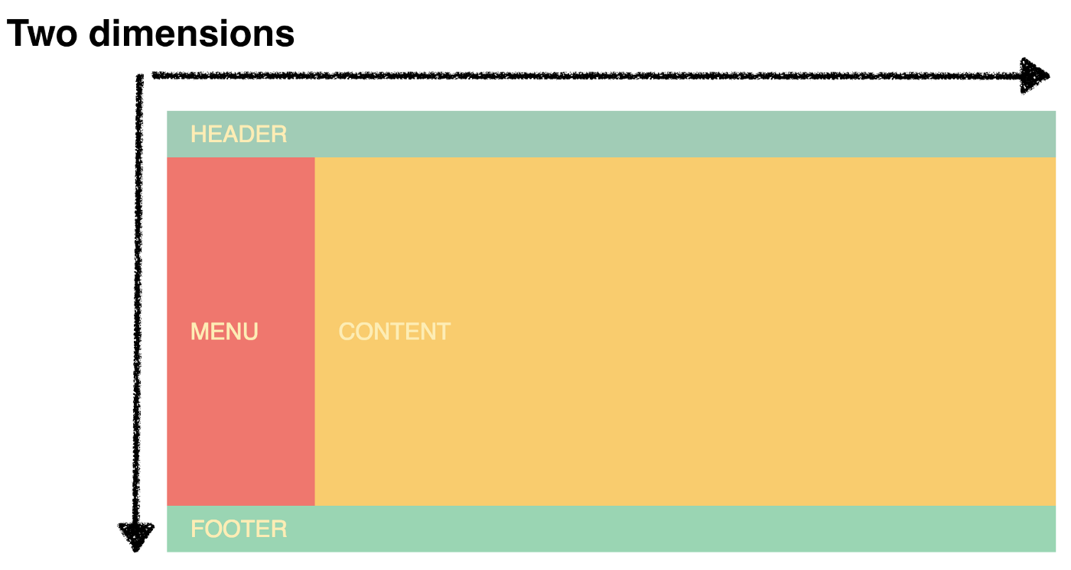
two dimension Layouts have both rows and columns

Slide 4
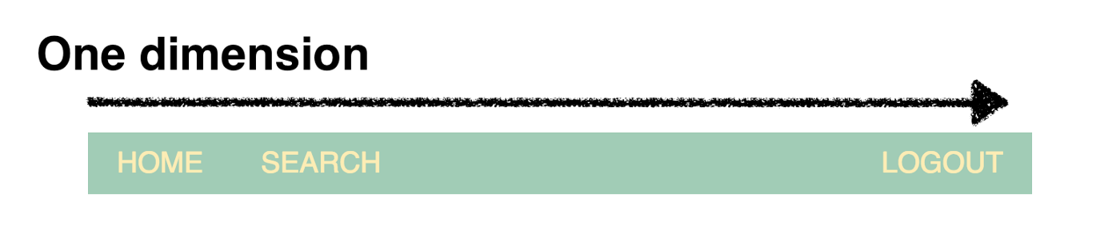
One dimension Layouts have only rows

Slide 5
Best Practices while handling one dimension and 2 dimension Layouts
One Dimension Layout - Use Flex Box
Two Dimension Layout - Use Css Grid

Slide 6
Grid Features and terminologies
A grid layout model works with all latest browsers.
It consists of two components which are grid container and grid items.
Grid Container
A grid container is a parent element that holds grid items placed within rows, and columns.
For the purpose of making an element adopt the behavior of a grid container set its display property to either grid or inline-grid.

Slide 7
Grid Features and terminologies
Grid Items
A grid item is a child element that is present inside a grid container.
Inside a container by default, there is one item present for each column, in each row.
However, you can span grid items across numerous rows and columns.

Slide 8
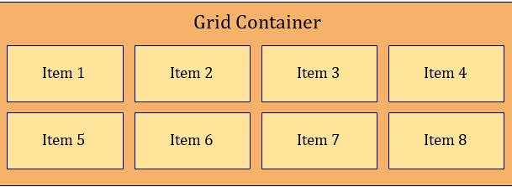
Grid Container and Grid Items

Slide 9
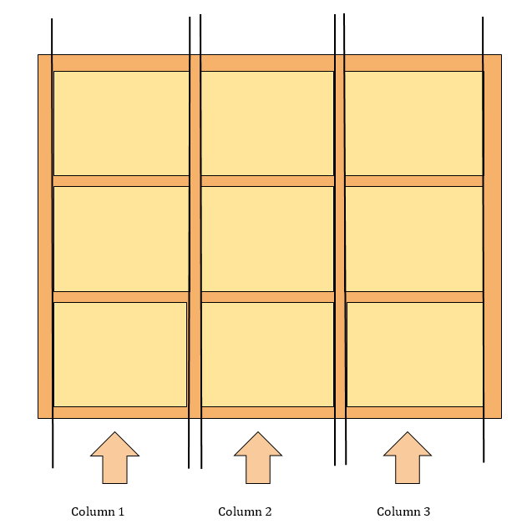
Columns in a Grid
The vertical lines in a grid within which items are placed are regarded as columns in a grid. A grid system can have at least two and at most twelve or more columns.

Slide 10
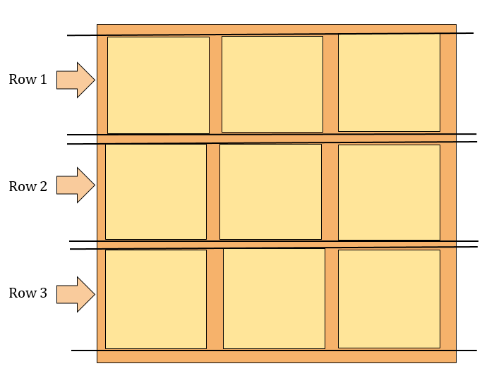
Rows in a Grid
The horizontal lines in a grid within which items are placed are regarded as rows in a grid. A grid system can have numerous rows.

Slide 11
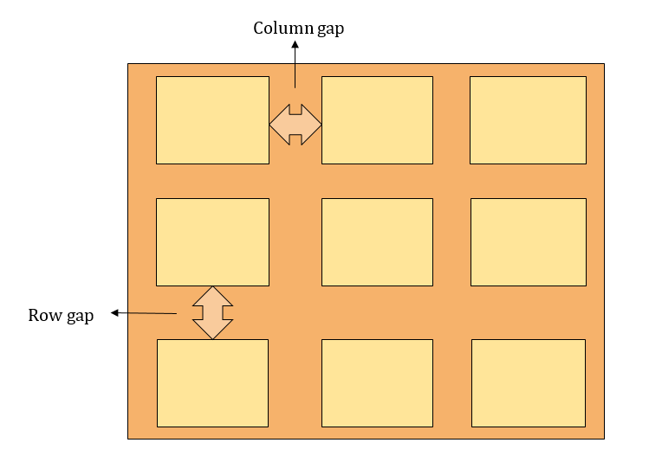
Gaps in a Grid
The area between each row, and column is referred to as gaps.

Slide 12
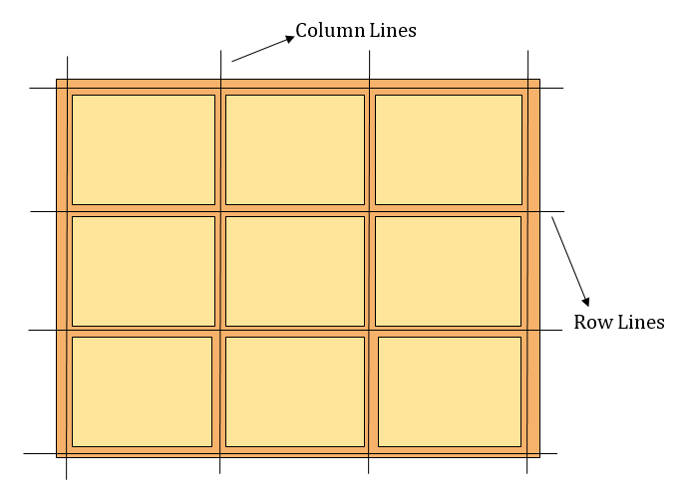
Lines in a Grid
The lines between each row is referred to as row lines, whereas, lines between each column is referred to as column lines.

Slide 13
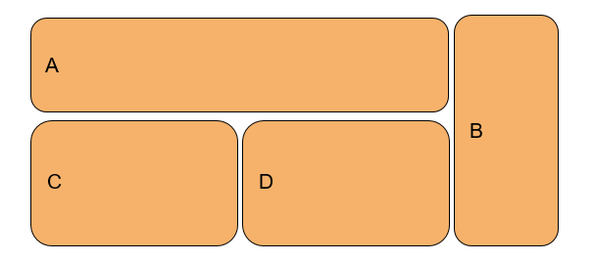
Lets start with an Example
In the example demonstrated below I have created a simple grid layout. The sketch of the grid is shown below.
<div class="container"> <div class="item color-1"> item-1 </div> <div class="item color-2"> item-2 </div> <div class="item color-3"> item-3 </div> <div class="item color-4"> item-4 </div> <div class="item color-5"> item-5 </div> </div>

Slide 14
HTML CODE
CSS CODE
<div class="container">
<div class="item one">A</div>
<div class="item two">B</div>
<div class="item three">C</div>
<div class="item four">D</div>
</div>
.container {
---Code here
}
.item {
---Code here
}
.one {
---Code here
}

Slide 15
Lets Get into Code

Slide 16
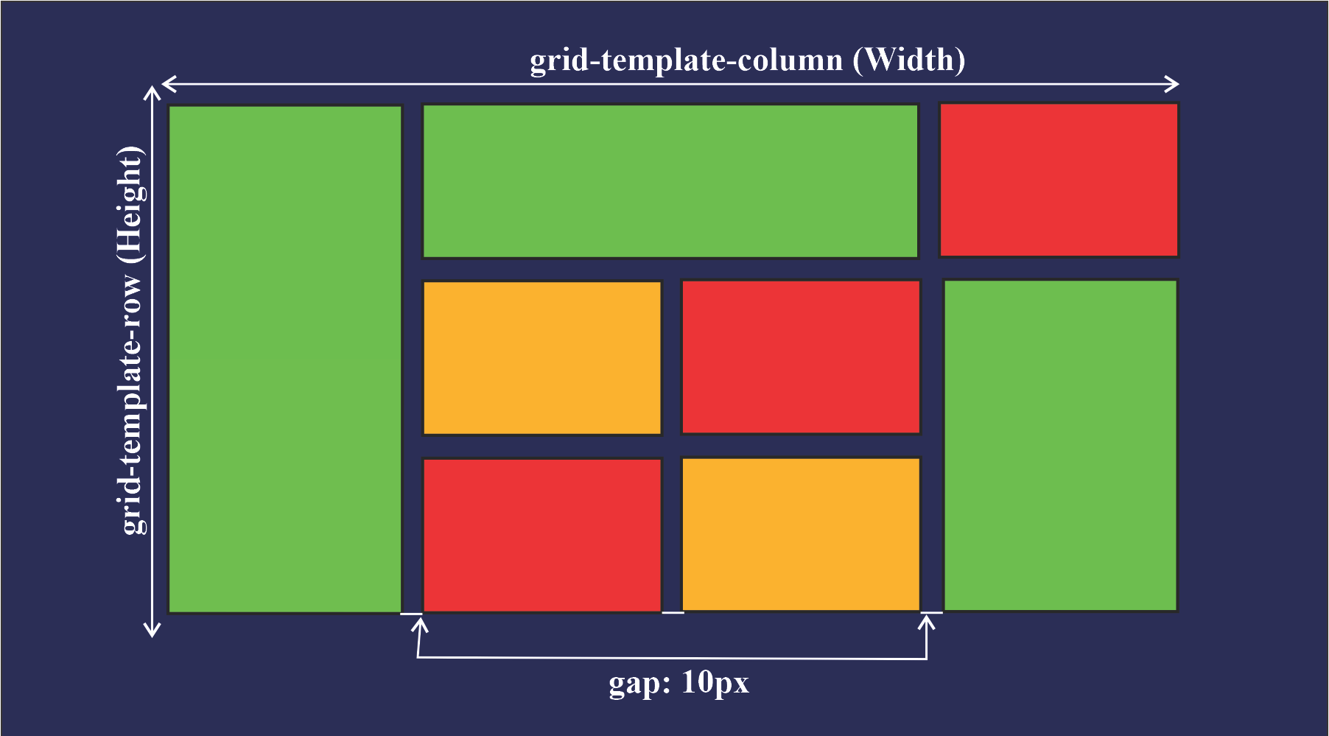
Example 2: try this as s challenge
<div class="container"> <div class="item color-1"> item-1 </div> <div class="item color-2"> item-2 </div> <div class="item color-3"> item-3 </div> <div class="item color-4"> item-4 </div> <div class="item color-5"> item-5 </div> </div>

Slide 17
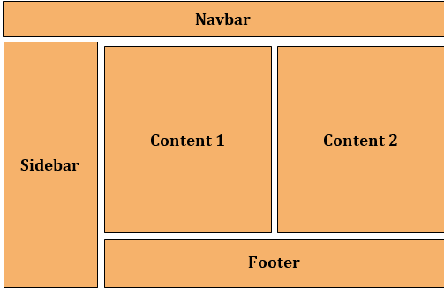
Example 3:

Slide 18
Example 3: try this as s challenge

